Slide 1
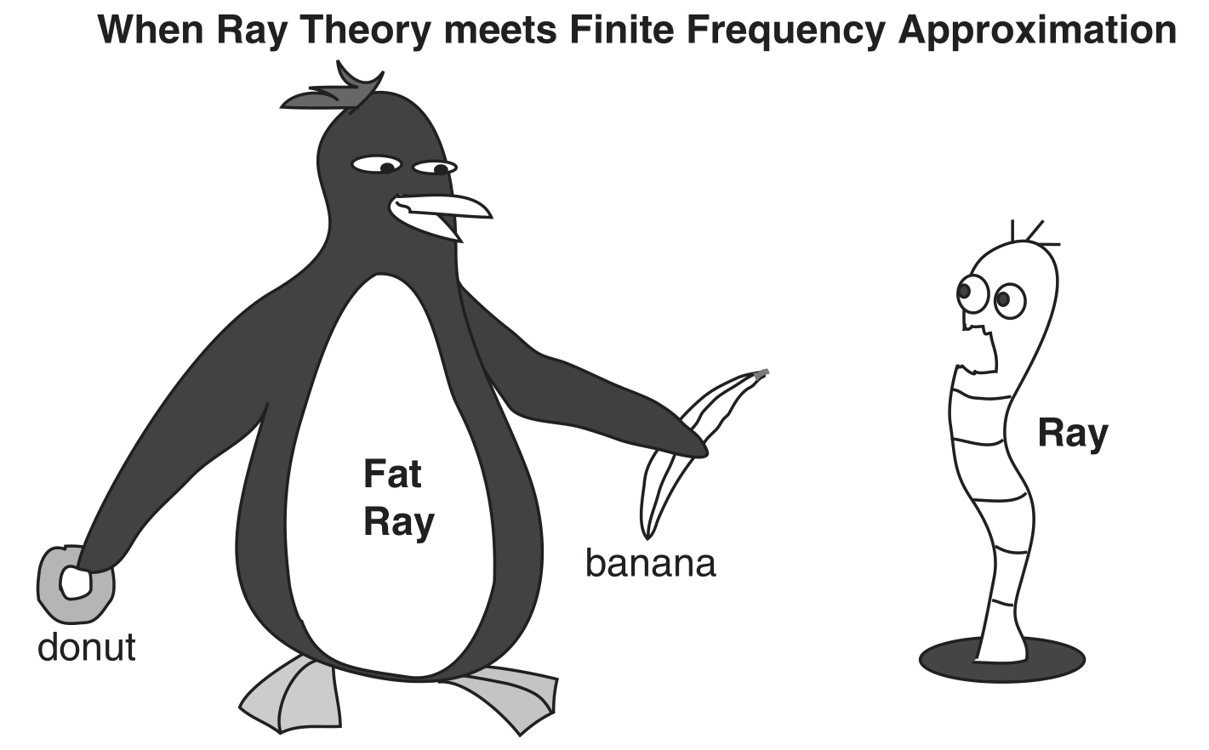
Liu, Q., Gu, Y.J., Seismic imaging: From classical to adjoint tomography, Tectonophysics (2012), http://dx.doi.org/
10.1016/j.tecto.2012.07.006

Slide 2
Outline
TV tower analogy
How to compute finite frequency kernels
Finite frequency kernels for full waveform tomography

Slide 3
Ray is an approximation

Slide 4
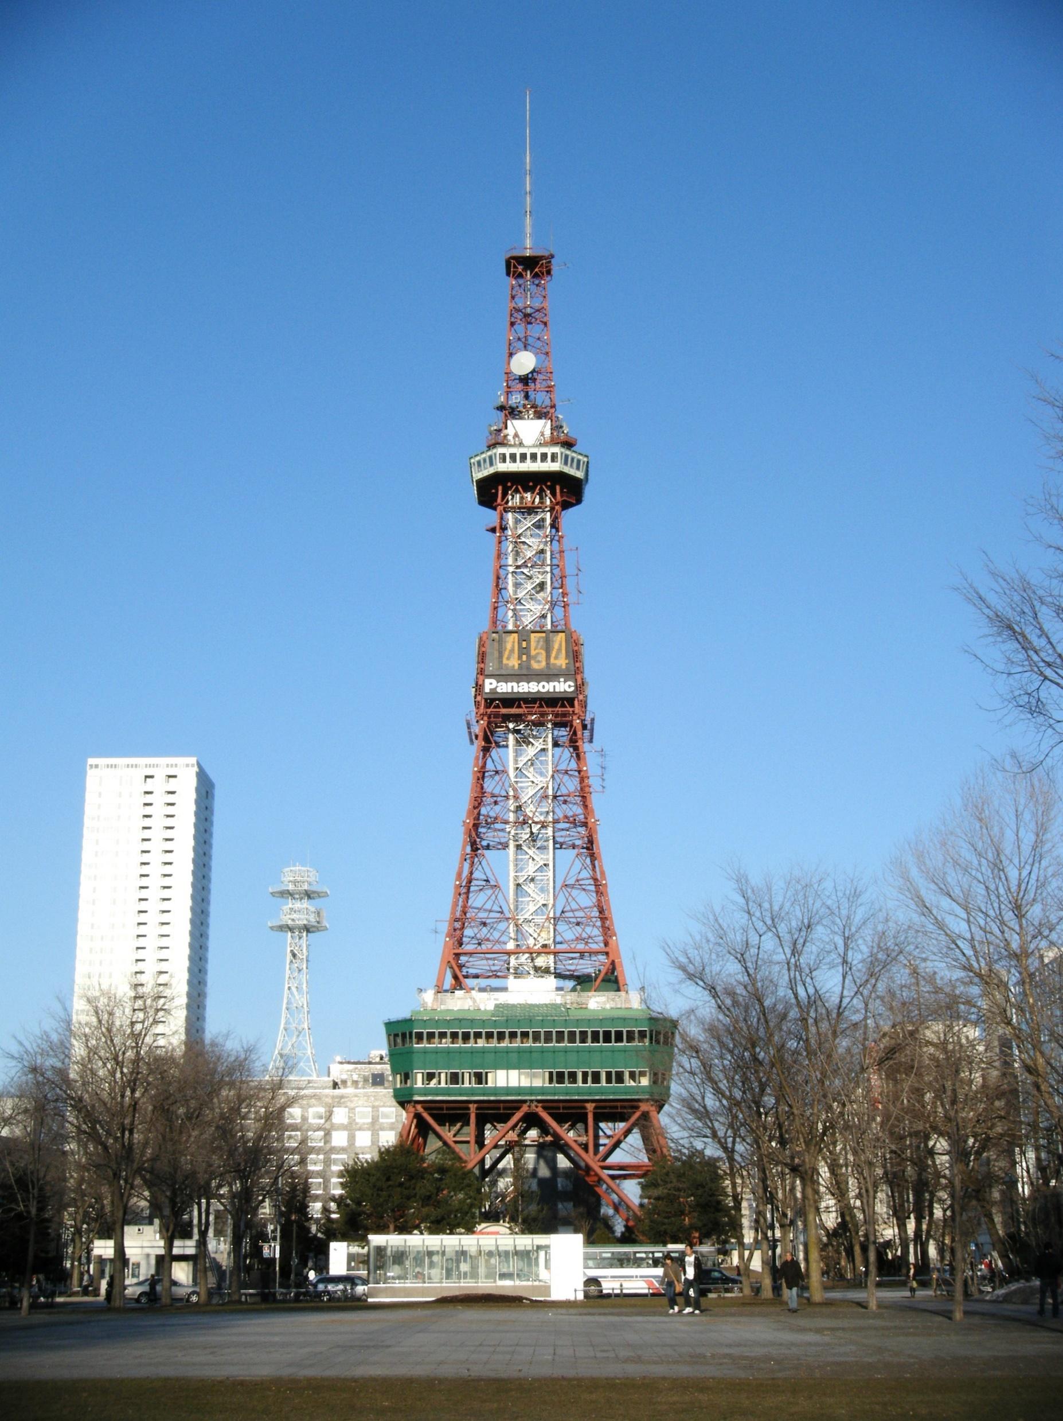
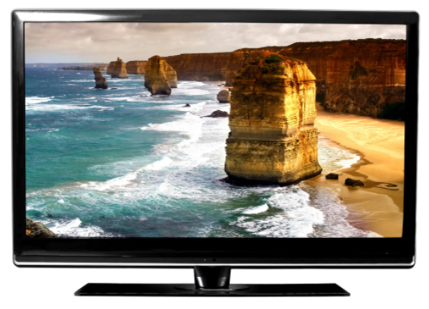
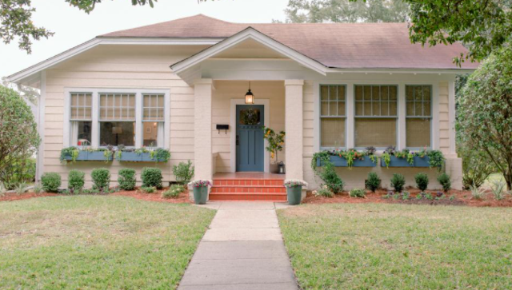
TV Tower Analogy
Transmitter
Receiver

Slide 5
Fresnel Zone
Transmitter
Receiver

Slide 6

Fresnel Zone
Transmitter
Receiver

Slide 7
Sensitivity kernel / finite-frequency kernel

Slide 8
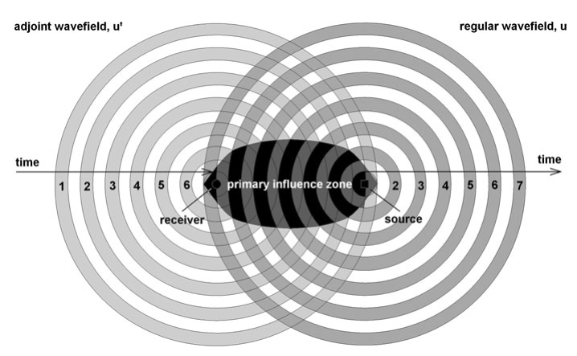
Interaction field
observed
Forward synthetic
misfit

Slide 9
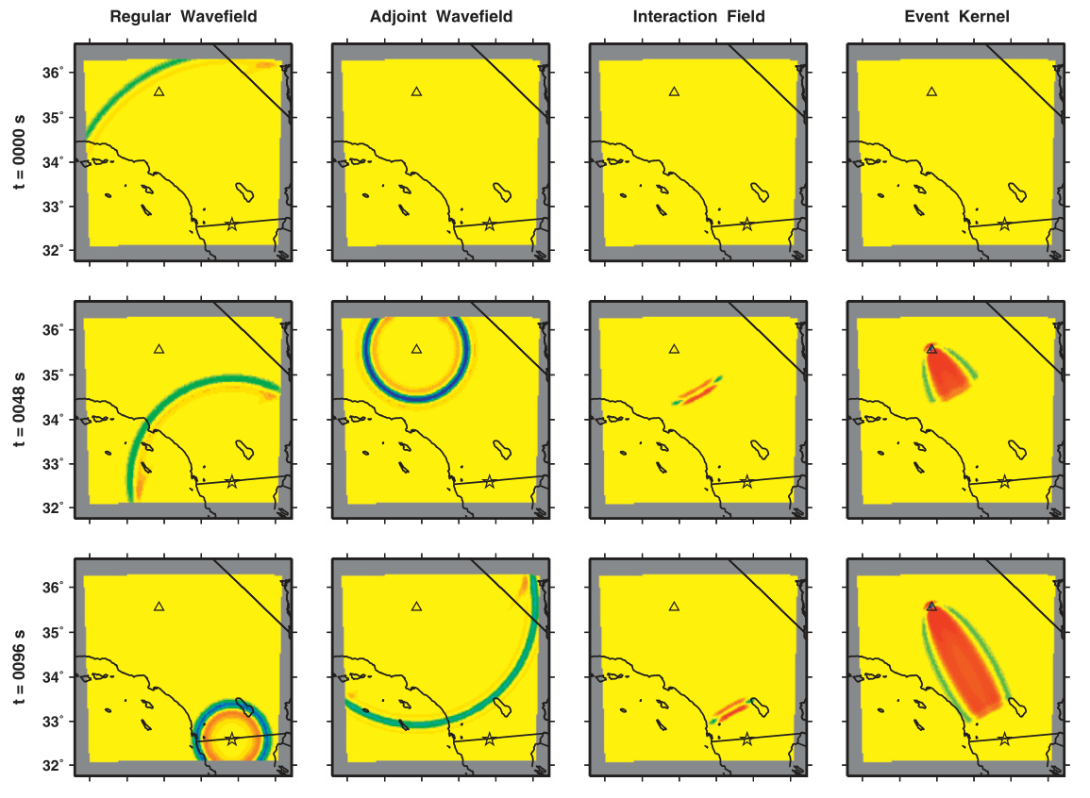
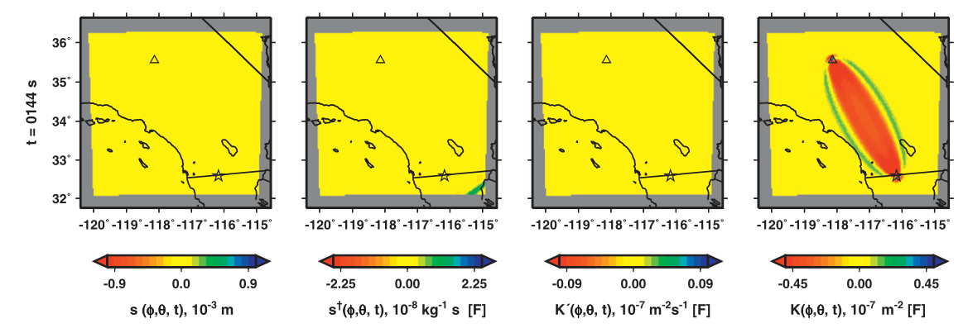

Slide 10
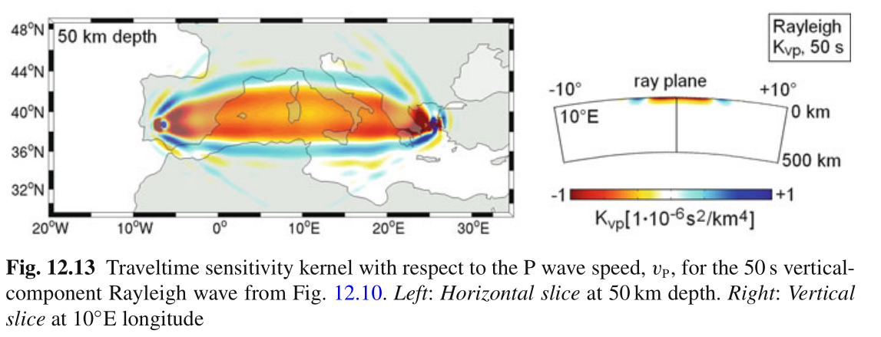
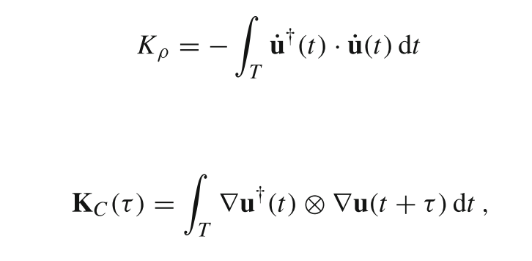

Slide 11
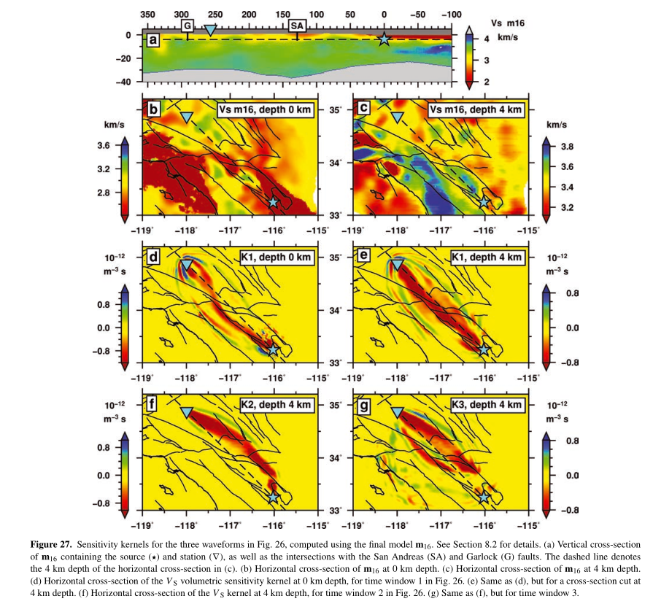

Slide 12
Conclusions
Ray theory relies on the assumption of weak and relatively large-scale heterogeneities.
Sensitivity kernels generally follow geometrical ray paths and occupy volumetric regions in the vicinity of the ray paths.

